Slide 1
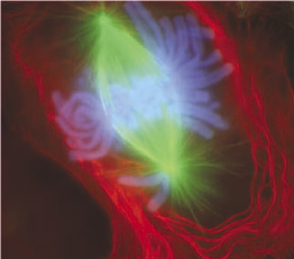
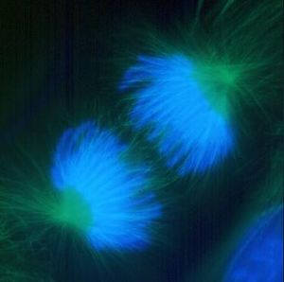
Monitoring HPV-related cervical precancers in Oregon
Sean Schafer, MD
HIV/STD/TB Program
Office of Disease Prevention
Oregon State Public Health
Notes:
Good afternoon. (These are micrographs of fluorescent stained newt lung cells in early and late anaphase of cell division. They’re mainly here because I like them though of course cancer does involve disturbance of cell division.)
This talk is about monitoring hpv-related cervical precancers in Oregon

Slide 2
I’m going to tell you…
1
In Portland since HPV vaccine introduction, the number of ….
Paps smears done
Pre-cancers diagnosed…
have declined
The number of …
Cervical pre-cancers occurring…
might have declined
Proportions of HPV types found in Portland pre-cancers have changed
2
3
Notes:
Some attention deficit disorder is common among a crowd of high-achievers like this, so I’ll start out by giving you the bottom lines. 1. In the Portland Metro Area, since HPV vaccine introduction in 2006, the number of Pap smears done and cervical pre-cancers diagnoses have declined.
The number of cervical pre-cancers occurring might have declined
Proportions of HPV type found in Portland precancers have changed since vaccine introduction
Now for the details

Slide 3
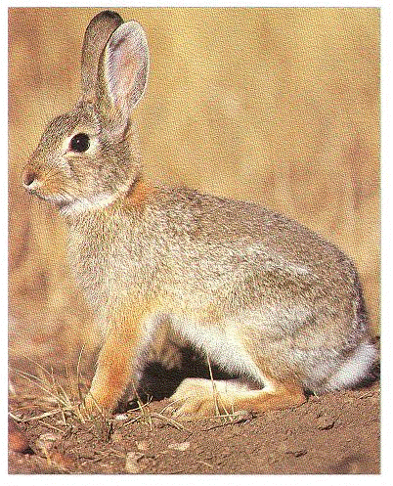
Papillomaviruses
Diverse
skin, mucous membranes
Cottontail rabbit wart, 1933
Species specific
Notes:
A few facts about Papillomaviruses in general. Papillomaviruses are a diverse group of viruses that infect skin and mucous membranes. Shope first isolated PV from a wart of a cotton tail rabbit 1933. They are very species specific. For example a human papillomavirus can’t ordinarily infect a rabbit nor can a rabbit virus infect a human.

Slide 4
Papillomaviruses
>100 types
Non-oncogenic (6, 11)
Oncogenic (16, 18, 45, 31, 33, 35, 52, 58, 51, 56, 59, 39, 68, [66])
Notes:
More than 100 different human types have been characterized. Most do not cause cancer and are called non-oncogenic. They cause cause genital warts, respiratory papillomas, and very often no visible lesions at all. In particular two non-oncogenic types (6 and 11) cause almost all genital warts and many minor abnormalities on Pap smears.
About 15 types can cause cancer and are known as oncogenic HPV. They’re listed in rank order of the proportion of worldwide cervical cancers they are believed to cause. Before HPV vaccine introduction, types 16 and 18 caused about 75% of cervical cancer in the US. 16 and 18 along with the other types listed caused well over 90% of all cervical cancer.

Slide 5
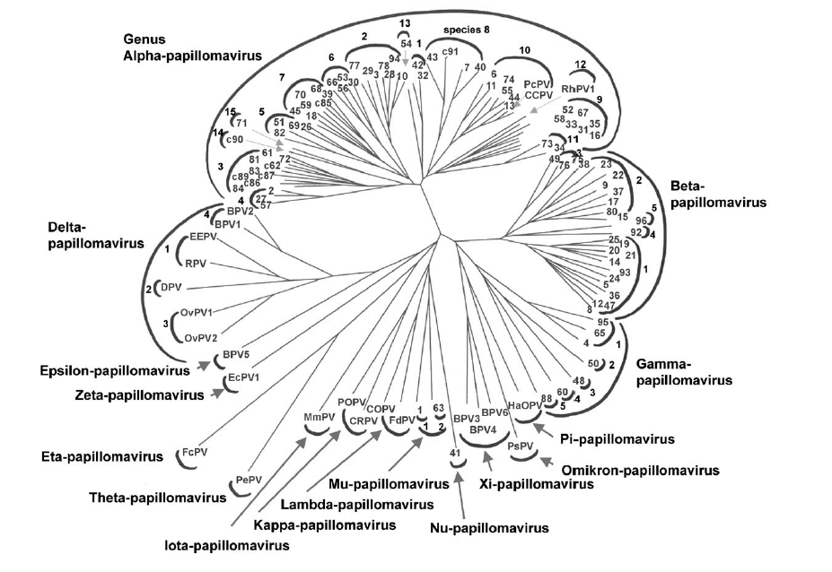
A7
A9
Notes:
The taxonomy gets complicated fast. There are 16 papilloma virus genus's, indicated by the outer arcs in the diagram. Species are indicated by smaller arcs within a genus, then types within species by numbers. The ability to cause cancer is related to the species. Species A9, that includes type 16, the most common cause of cervical cancer worldwide has the most oncogenic types, followed by A7 that includes HPV type 18.

Slide 6
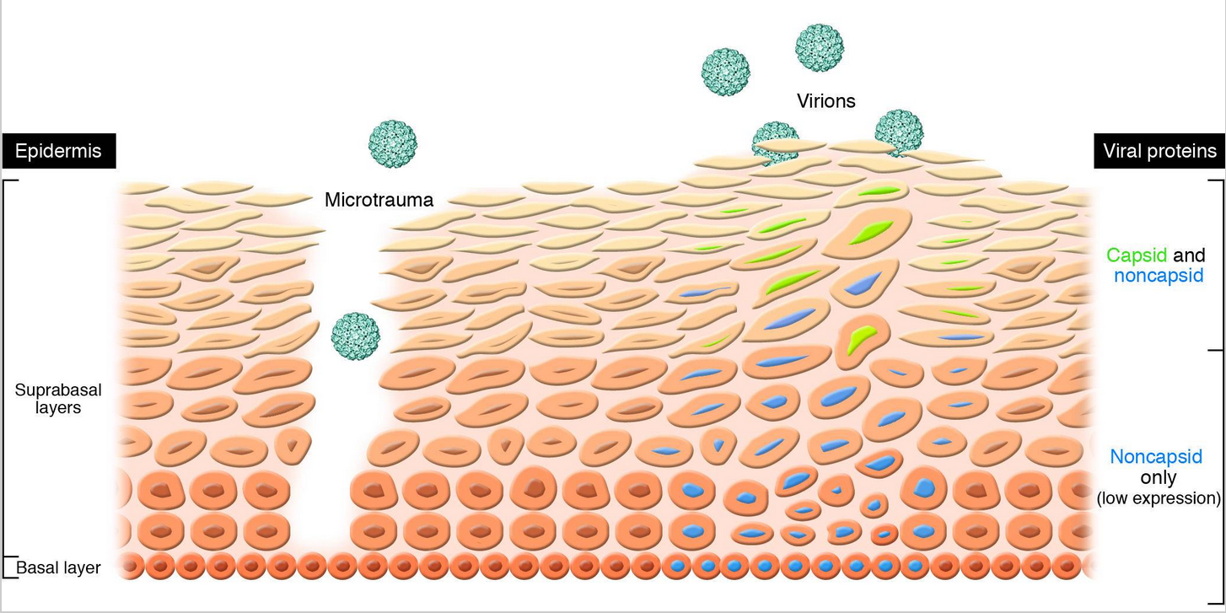
Lowry DR, Schiler JT. Prophylactic human papillomavirus vaccines. J Clin Inv. 2006;116(5)
Notes:
This is a cartoon representing a cross-section of the microscopic appearance of surface of the cervix during infection with HPV.
Think of the top of the diagram as the outside surface.
To establish infection, the virus has to infect basal cells at the bottom, that are long lived and sort of multipurpose, not physically tough like the surface cells.
But when they divide, their progeny ascend to the surface and change, or differentiate, into very specific cells that make up the surface.
Tiny abrasions, such as those that happen with sexual intercourse enable viruses sluffed from the skin of a partner to gain access to the basal layer cells.
The viruses are taken up by the basal layer cells and the virus’s genetic material—lets call it the virus’s chromosome even though that’s not a technically correct usage—takes up residence inside the basal cell nucleus. The virus depends on the cells to read its chromosomes and make the proteins necessary to produce new copies of the virus.
But basal cells don’t readily read the viral genes, so they don’t make new viruses.
But when the basal cells divide, their progeny start ascending to the surface via the intermediate suprabasal layers and begin to differentiate into surface cells. These differentiating cells read the viral genes much more actively and produce new viruses that are released as the cells ascend and are sloughed off.
The presence of the virus causes microscopically visible abnormalities, including papillomatosis—small elevations on the surface,
parakeratosis—retention of the nucleus,
and koilocytosis—larger darker staining nuclei that often have a halo around the nucleus.

Slide 7
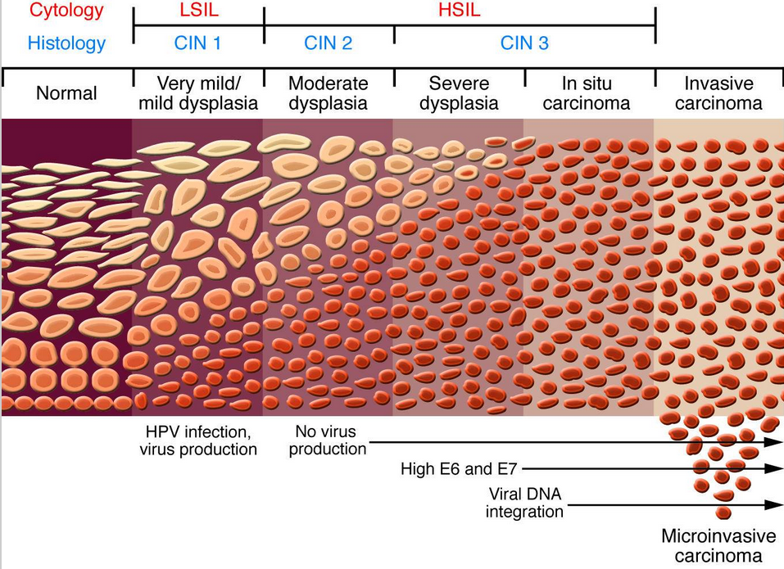
Lowry DR, Schiler JT. Prophylactic human papillomavirus vaccines. J Clin Inv. 2006;116(5)
Notes:
Most HPV infections, including oncogenic types such as HPV 16, don’t persist and are relatively quickly eliminated through natural immunity.
Sometimes, infections persist for longer than a few months.
Sometimes, when persistent infection by an oncogenic type occurs, minor benign changes or low-grade dysplasia, also called cervical intraepithelial neoplasia or CIN appear.
In mild dysplasia or CIN 1, cells near the basal layer fail to differentiate as quickly, and show nuclear changes called koilocytosis.
None of this is evident upon inspecting the cervix without magnification using a colposcope, taking a sample of surface cells—a Pap smear, or taking a small piece of the cervix, a biopsy, for examination by a pathologist.
Most CIN resolves on its own.
Sometimes sustained infection by oncogenic types causes more substantial changes where undifferentiated cells occupy most of or even all of the thickness of the epithelium. This condition is recognized as moderate or severe dysplasia or CIN 2 or CIN 3 depending on how much of the full thickness of the mucosal skin is involved. CIN3 and Carcinoma in Situ are generally thought of as synonyms.
Frank cancer, also known as invasive carcinoma is present when undifferentiated cells invade the dermis tissue below the basal layer.
In most cases, the interval from inoculation with an oncogenic HPV virus until development of cancer—the incubation period if you will—takes 5 to 20 years.
Pap smears can detect CIN1, 2 and 3, and women with these abnormalities can be treated to prevent development of invasive cancer. That is why Pap smears have been such an effective tool for reducing Cervical Cancer over the past 60 or 70 years.

Slide 8
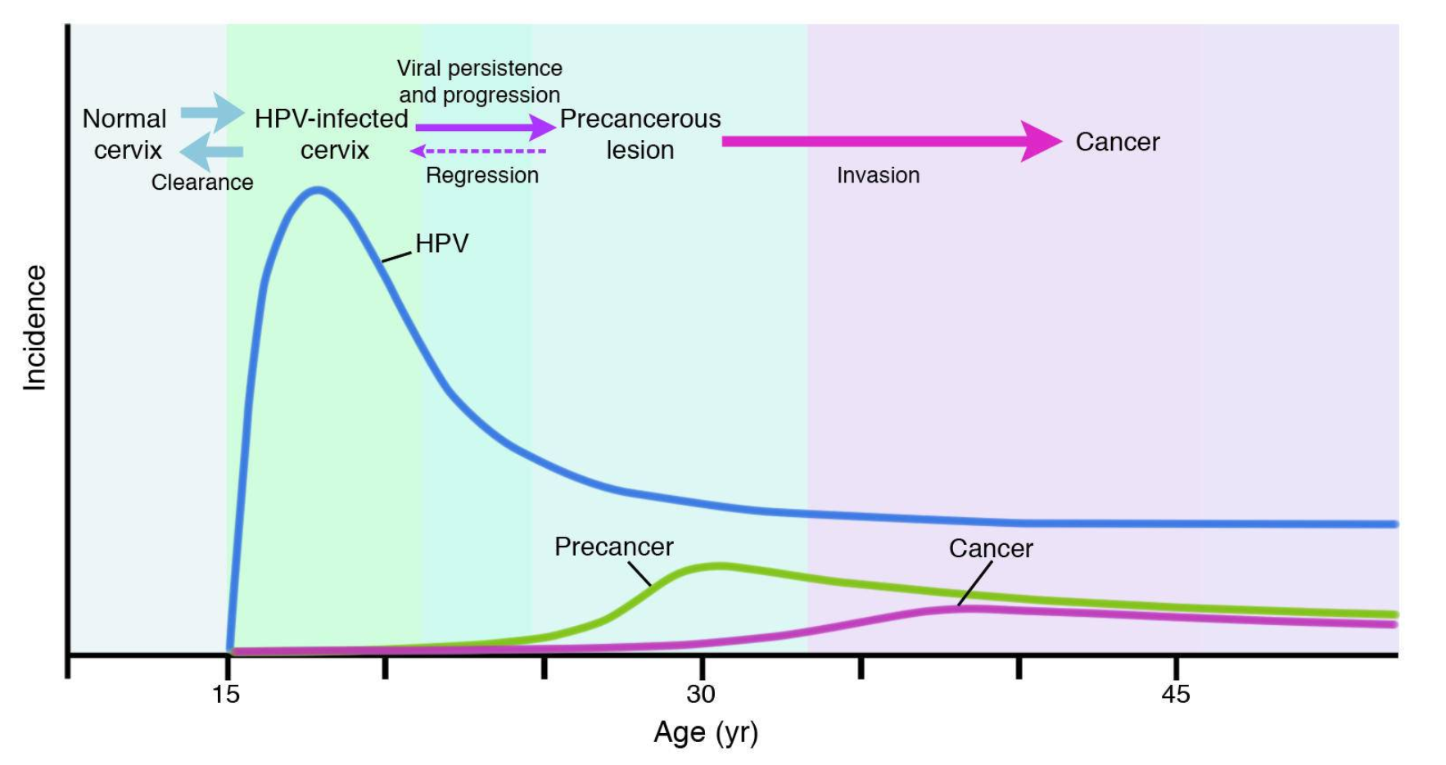
Lowry DR, Schiler JT. Prophylactic human papillomavirus vaccines. J Clin Inv. 2006;116(5)
Notes:
Altogether this process takes years.
Here’s a cartoon depiction of the typical time courses of HPV-related cervical events starting at the time women to engage in vaginal intercourse. HPV infections are very common. Approximately 50% of women will have had at least one cervical or vaginal HPV infection within 2 years of first sexual intercourse and over 80% of women will have such an infection in their lifetime. Nearly all of these regress or resolve on their own. In a small number of cases infections with oncogenic types persist and the first precancers can be observed 2 to 10 years after exposure, left untreated, many of these will also resolve but invasive cancer will occur a few within 5 to 25 years in a very small proportion of women originally exposed if the prelimary CIN 2 and 3 are not identified by Pap smears.

Slide 9
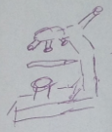
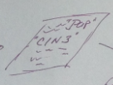
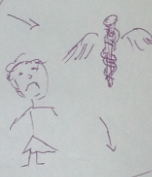
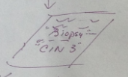
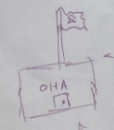
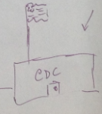
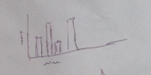
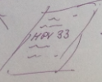
Monitoring HPV-related CIN2+, Portland
Notes:
The program we operate at Oregon Health Authority monitors occurrence of HPV-related CIN2+ disease among women aged 18 years and older who live in the Portland metropolitan area. It’s pretty simple. A woman goes in for a routine Pap smear with her regular provider depicted in the upper left. The pathologist looks at the Pap smear slide in a microscope notices cellular changes like koilocytosis and parakeratosis and reports that the Pap smear is consistent with CIN2 or CIN3. The woman returns to her physician who gives her the disappointing news and refers her for a biopsy of the cervix done with the aid of a special low-power microscope called a colposcope. The biopsy is read by the pathologist. If the pathologist determines that CIN 2 or CIN 3 is present, then the pathologist must send an electronic copy of his or her report over the wires to OHA. In turn OHA asks the pathologist to send a sample from the biopsy to CDC. CDC tests the tissue for HPV types and sends those results to OHA. In turn, we report the incidence of CIN2+ and the types of HPV found.

Slide 10
Cervical Dysplasia Surveillance Methods
Case definition
18 years of age or older
Reside in 28-zip-code area in Portland metro area
Biopsy confirmed Cervical Intraepithelial Neoplasia (CIN) 2, CIN 3, CIN 2/3, Adenocarcinoma-in-situ (AIS)
Data
Pathology report
Demographics – from lab or provider
HPV vaccine history – from ALERT or provider
Specimens for HPV typing
Notes:
Here’s the written version.

Slide 11
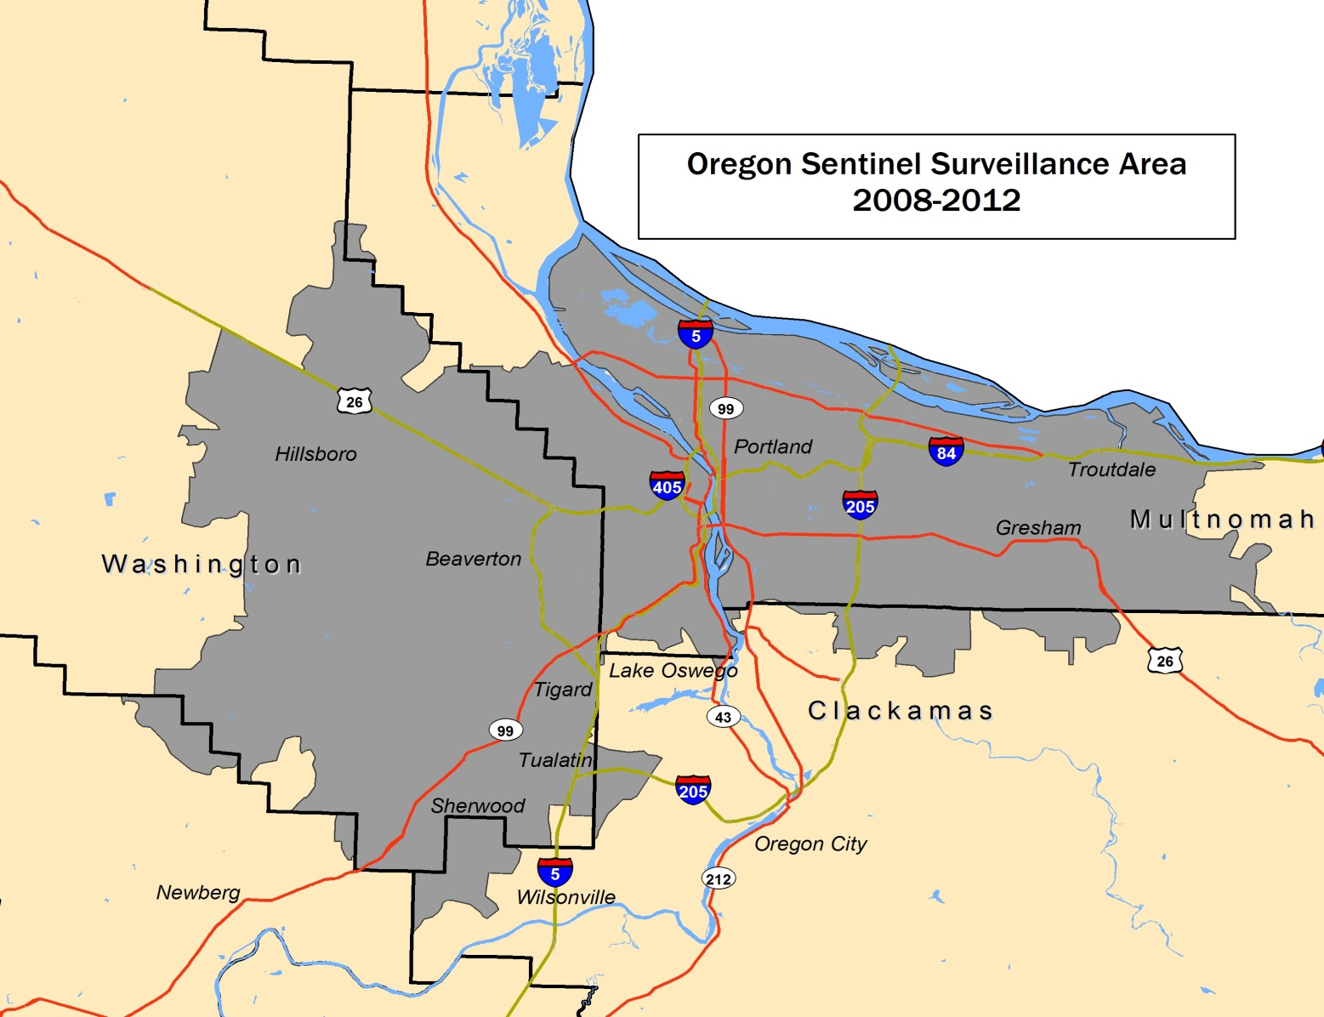
Oregon’s Surveillance Area
Columbia River
Columbia River
Portland Metropolitan Area: Oregon
Notes:
The surveillance area includes 28 contiguous zip codes containing most of metropolitan portland

Slide 12
HPV Monitoring Objectives
Incidence of high-grade cervical dysplasia (precancers, “CIN2+”)
Prevalence and distribution of HPV types
Notes:
The main objectives of the project are to:
Estimate the incidence of High grade cervical dysplasia, CIN2+ or higher.
Describe trends in HPV types found in biopsies of CIN 2+ cases over time.

Slide 13
Notes:
Let’s look at some data. This graph depicts the annual number of CIN2+ diagnoses in woman aged 18–20 years by year from 2008 through 2014. So far so good, this is the youngest age for which we have CIN2+ reports and this group is most likely group for which we have data, to have been vaccinated.
Most of those who were 18–20 years old in 2008 probably had not been vaccinated, but by 2014, a lot of 18 year-olds had received at least one HPV vaccine.
And the number of reported new diagnoses per 100,000 population in this age group obviously fell.
That’s encouraging

Slide 14
History of American Cancer Society
Cervical Cancer Screening Guidelines
Pap (21–29)
Pap plus HPV test (30–65)
Conventional or liquid Pap
Pap
Pap
Pap
Part of regular checkup
Yearly, every 3 years if consecutive negative
Yearly, “less frequent” if 3 consecutive negative
Yearly if conventional Pap, every 2 years if liquid Pap
Every 3 years
(21–29)
Every 5 years (30–65)
≥ 20y or upon first vaginal intercourse
≥18y or upon first vaginal intercourse
3y after first vaginal intercourse
21y
None
70y if 3 consecutive neg.
65y
None
None
None
1980
1987
2002
2012
Notes:
But now we need to remind ourselves that CIN2+ isn’t a condition that can be recognized unless a woman undergoes a Pap smear.
So if Pap smears declined, we’d expect to see a corresponding fall in the number of new CIN diagnoses.
As it happens, recommendations of the major professional and topical organizations changed a lot from 2008 to 2012.
The timelines vary somewhat by organization, but here is a chart of the history of guidelines of the American Cancer Society.
Before 1980 the recommendation was for a Pap smear as part of a regular checkup, but no start or stop ages were specified.
Beginning in 1980, ACS recommended annual Pap smears beginning at age 20, or earlier, upon first vaginal intercourse.
Annual Paps could be stretched out to 3 years if a woman had consecutive negative Pap smears. No stop age was advised.
Then in 1987 the start age was lowered to 18 years or age at first intercourse, and the interval could be lengthened if consecutive Pap smears were negative.
Then in 2002, a new method of Pap smear called the liguid Pap smear arrived that was considered more sensitive, so a woman could have annual conventional Pap smears, or liquid Pap smear every two years beginning 3 years after first vaginal intercourse.
For the first time a stop age of 70 was advised if preceded by 3 consecutive negative annual Pap smears.
Then, most recently in 2012, no Pap smears were recommended until age 21 and the interval became every 3 years until age 29 and after age 29 the interval increased to 5 years and two tests were recommended, a Pap smear and an HPV test.
So indeed, guidelines recommend many fewer Pap smears since 2012, and none at all for women under 21 years regardless of age at first vaginal intercourse.

Slide 15
Notes:
So now let’s overlay screening on our CIN 2+ diagnoses, the proportion of women in this age group screened by year represented by the pink line.
Guidelines ceased recommending any pap smears at all for women less than 21 during this period and consistent with that recommendation, the annual proportion of women aged 18–20 years that had a Pap fell from over 20% to less than 5%.
We use a method for estimating Pap smears that counts the proportion of insured women with ≥1 Pap smear per year and from this, estimates the proportion of uninsured women screened by reducing the estimate for screening in insured women by the amount that surveys tell us uninsured women are less likely to be screened. Then we fold those two estimates back together.
Now it isn’t so clear that the actual occurrence of CIN2+ is declining more than would be expected by screening.

Slide 16
Notes:
Similarly, among women ages 21-29, cervical cancer diagnoses decreased by 25% from 2009 to 2014.
However, consistent with guideline changes that reduced recommended screening frequency to every 3 years, we estimate that the proportion of women with at least one pap by year fell from 35% to 20%.
Again, not so clear whether the true underlying occurrence of CIN 2+ has fallen.

Slide 17
Notes:
In women aged 30-39 years reported diagnoses of CIN do not appear to have declined though, again consistent with recommendations, proportion screened fell substantially. So in this age group, diagnoses remained unchanged while screening decreased. Another way to describe this is to say that the number of CIN2+ diagnoses per Pap smear increased. This pattern is not inconsistent with no change, an increase or even a decrease in true CIN2+ occurrence. Given that almost none of these women had been vaccinated or initiated vaginal intercourse in a era where others had been vaccinated, I tend to think that actual incidence of CIN2+ remained unchanged.

Slide 18
I’m going to tell you…
1
In Portland since HPV vaccine introduction, the number of ….
Paps smears done
Pre-cancers diagnosed…
have declined
The number of …
Cervical pre-cancers occurring…
might have declined
Proportions of HPV types found in Portland pre-cancers have changed
2
3
Notes:
Just a reminder, we’ve accomplished number 1 and number 2. Since HPV vaccine introduction, the number of Paps smears done and the number of pre-cancers diagnosed have declined. The number of precancers actually occurring might have declined. Now let’s tackle number 3…HPV typing from our CIN2+ cases.

Slide 19
N=1728
Notes:
To begin, we received reports of several thousand cases of CIN2+ but we only sent tissue from a subset of cases to CDC. So far we have HPV type data from 1728 cases. Cases among women aged 18–20 are rare because screening is not regularly done. Only 40 of cases in women under 21 have been typed so far. Many more cases among women aged 21–29 and 30–39 have been typed. Also, completely unvaccinated women prevail by about 3 or 4 to one in women under 30 and by a much larger amount in women over 29. This is true among all cases, not just those for which HPV typing is available. The reason for this is potentially three-fold. To the extent that the vaccine prevents CIN2+, fewer vaccinated women would be expected to appear among the CIN2+ cases. Secondly, most of the women whose cases are represented here were well past the recommended age for vaccination of 11 to 13 years when the vaccine was introduced and past or well into the age range for which catch up vaccination was recommended. The third explanation is presumably one of the reasons we’re here today. Uptake of the vaccine has been less than complete.

Slide 20
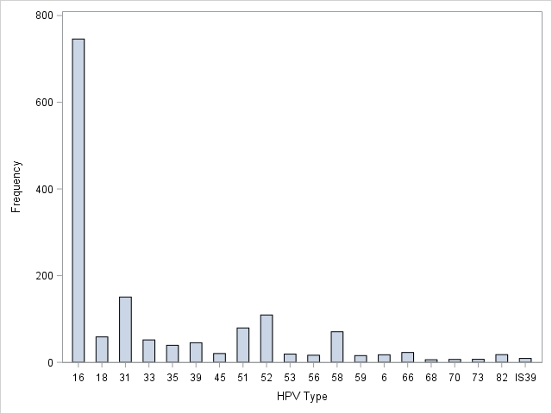
HPV Types, CIN2+, Portland Oregon, 2008–2016
600
N=1728
400
Count
200
16
18
31
33
35
39
45
45
52
53
56
58
59
6
66
68
70
73
82
IS39
HPV Type
Notes:
Out of 1728 typed, almost 800 or about 45% contained HPV 16. Fewer contained HPV 31 (about 9%), 52 (about 6%), 45 (about 4%) or 18 or 58 (each about 2 to 3%)

Slide 21
Gardasil
(HPV 6,11,16,18)
Cervarix
(HPV 16,18)
Gardasil 9
(HPV 6,11,16,18,
33, 31, 45, 51, 58)
2006
2009
2014
Notes:
Okay. This isn’t a vaccine talk and I’m not a vaccine expert, but it’s helpful to review the recent history of FDA approval of HPV vaccines. In 2006, FDA approved Gardasil, produced by Merck, the first US licensed HPV vaccine effective at preventing sustained infections and dysplasia caused by HPV 6 and 11, the two non-oncogenic types that cause most genital warts, and types 16 and 18, the two oncogenic types believed to cause over 70% of cervical cancer worldwide. That was followed in 2009 by FDA approval of Cervarix produced by Glaxo Smith Kline, a vaccine that prevented sustained infections and dysplasia caused by HPV 16 and 18. Then in 2014, FDA licensed a 9-valent vaccine, Gardasil 9 that added oncogenic types 33, 31, 45, 51 and 58 to 6, 11, 16 and 18.

Slide 22
Notes:
By the way…it’s a made up word, but will anyone besides me cop to wondering the “correct” way to pronounce “C-E-R-V-A-R-I-X”
We’ll in my opinion just one more sign that the apocalypse is upon us, one can go to youtube to learn the secret your doctor won’t tell you … its ”cer’-vuh-rix”

Slide 23
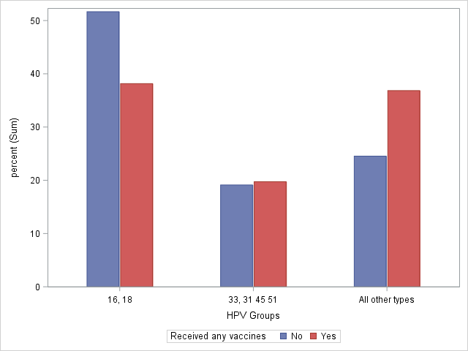
HPV Types, CIN2+, Portland Oregon, 2008–2016
Vaccinated NO YES
Percent
16,18
33, 31, 45, 51, 58
All Others
HPV GROUPS
Notes:
So in mind of the oncogenic types in the first 2 licensed vaccines, 16 and 18 and the types added in Gardasil 9. We notice something indirect that is quite interesting and reassuring. Women with CIN2+ who had received any HPV vaccine prior to the date of diagnosis or CIN2+ types 16 and 18 were less commonly found and non-vaccine types were proportionally greater. This does not indicate that CIN caused by non-vaccine types was more frequent among unvaccinated women in absolute terms, simply that among those fewer cases of CIN2+ that were reported among women with any HPV vaccination, a higher proportion had non-vaccine HPV types in their cervical biopsy. This is exactly what we’d hope to see. When a vaccinated women does happen to get CIN2+ it’s less likely to be caused by a vaccine type, indicating protection by the vaccine. Since the 9-valent vaccine is quite new, we expect to see a slightly higher proportion of vaccinated women with CIN2+ caused by these types for the same reason. However the proportion isn’t meaningfully higher.

Slide 24
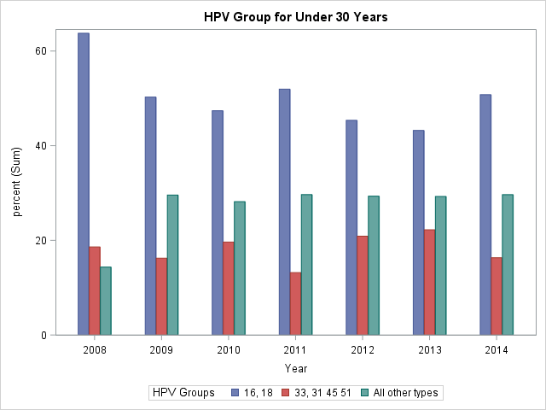
HPV Types, CIN2+ Cases in Women Aged <30 years,
By Year, Portland, OR, 2008–2014
HPV Groups: 16,18 33, 31, 45, 51 58
All other types
60
40
Pct
20
0
2008
2009
2010
2011
2012
2013
2014
Year
Notes:
Okay. This shows proportion of HPV types grouped into 16 and 18, protected by the first two HPV vaccines introduced, and 33, 31, 45, 51 and 58, protected by the more recent 9-valent vaccine and all others for women aged less than 30 at the time of CIN diagnosis by year of diagnosis. We’ve grouped women aged 18–20 years with women aged 21–29 because we had very few cases that were typed among women in the younger group. This is the same information presented in the previous slide. Even when you remember that most of these cases occurred in women who were beyond 13 years old when HPV vaccine became available, you see the relative proportions of the vaccine types 16 and 18 decreased from over 60% of lesions to 40 or 50% of lesions. While the non 16 and 18 types increased proportionally in turn. Again, exactly as we’d expect with vaccine preventing CIN2+ from 16 and 18 and no from the other types.

Slide 25
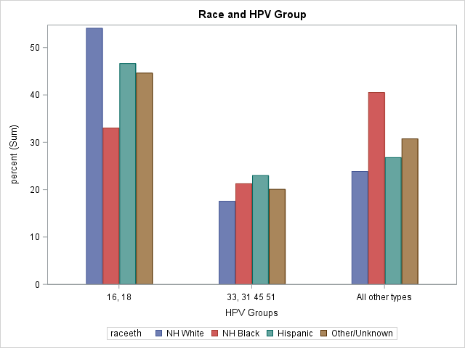
HPV Types, CIN2+ Cases in Women Aged <30 years,
Portland, OR, by Race, 2008–2016
50
NH White
NH Black
Hispanic
Other/Unk
40
Pct
20
10
0
16, 18
33, 31, 45, 51, 58
All other
Notes:
In the last slide on HPV type, we look at race by HPV types, again grouped by the two early vaccine oncogenic types, 16 and 18, the additions in the 9-valent vaccine and all other HPV types. This is really fascinating. When we aggregate our data with the other 4 states that are conducting CIN2+ surveillance we see a similar trend. Other authors have noted as well. A higher proportion of Non-Hispanic white women have lesions caused by the vaccine types than non-Hispanic blacks, Hispanics and women of other races or whose race isn’t known. Correspondingly, the non-white groups have higher proportions of other HPV types. In theory, this could be seen by higher rates of vaccination among non-whites, giving more of them protection against 16 and 18, and in fact, according to the Oregon Immunization Program, the proportions of non-white adolescents that have received 1 or more HPV vaccination exceeds the proportion of white adolescents that received at least on HPV vaccination. On the other hand, similar racial differences were observed for HPV types prior to vaccine influenced data such as these. These differences most likely result from differences in sexual networks but they certainly point out the importance of additional subtype inclusion in the vaccine to minimize differential benefit by race.

Slide 26
I told you…
1
In Portland since HPV vaccine introduction, the number of ….
Paps smears done
Pre-cancers diagnosed…
have declined
The number of …
Cervical pre-cancers occurring…
might have declined
Proportions of HPV types found in Portland pre-cancers have changed
2
3
Notes:
So I’ve done it. I’ve told you…Pap smears and cervical precancer diagnoses have declined, cervical precancers occurring might have declined, and proportion of HPV types found in pre-cancers have changed…in directions consistent with protection by the vaccine against precancer.

