Slide 1
Oregon HPV Vaccination Landscape, 2016
Steve Robison
Oregon Immunization Program

Slide 2
Local Immunization Rate Source
Oregon Immunization Program (OIP)- publishing adolescent immunization rates for the last four years
Data source here is the Oregon ALERT Immunization Information System

Slide 3
ALERT IIS Background
ALERT Immunization Information System (IIS) is Oregon’s immunization registry.
ALERT captures immunization records from providers, pharmacists, payors, billing exchanges, health plans, local health departments
ALERT IIS contains both child and adult immunization records.
ALERT IIS captures most of the immunizations given in Oregon

Slide 8
Oregon HPV Immunization
Oregon rates for 1+ and 3 HPV immunizations among girls are showing only slight increases for the last 4 years
Oregon rates for 1+ and 3 HPV immunizations among boys are continuing to increase.
By race, white adolescents are less likely to initiate and complete HPV immunizations than groups
Hispanic adolescents are also more likely to initiate and complete HPV immunizations than other groups
Greater chance of HPV initiation with increasing income

Slide 10
HPV & Other Adolescent Immunization Rates
HPV is not the lowest immunization rate (influenza- 24%)
Not likely HPV immunization rates will catch up to tdap (92%), because of school mandate for tdap
Reasonable that HPV initiation can catch up to meningococcal immunization rates (70%).

Slide 12
Oregon County HPV Immunization Mapping
Generally HPV immunization is lower in the southern and rural portions of Oregon
An alternative way to look at HPV immunization mapping is by the percentage in local areas that have not initiated.

Slide 15
Oregon Zipcodes Where More than 40% of Girls Age 13-17 Have Not Started HPV Immunization as of May 2016

Slide 16
Oregon Zipcodes Where More than Half of Girls Age 13-17 Have Not Started HPV Immunization as of May 2016

Slide 17
Dimensions of the Problem (Data-Driven)
Start on-time
Co-administer with other vaccines
Watch for missed opportunities
Create more opportunities

Slide 18
On-Time Start
The point of immunization is to prevent disease;
Shots need to be given before exposure, not after.
Starting on time in Oregon almost doubles the chance of finishing the three dose series.

Slide 20
Co-Administration & Missed Opportunities
Adolescents can visit clinics for a variety of reasons
Tdap immunization visits (school required for 7th grade) present a chance to give other immunizations
Clinics should check for immunizations at every encounter

Slide 23
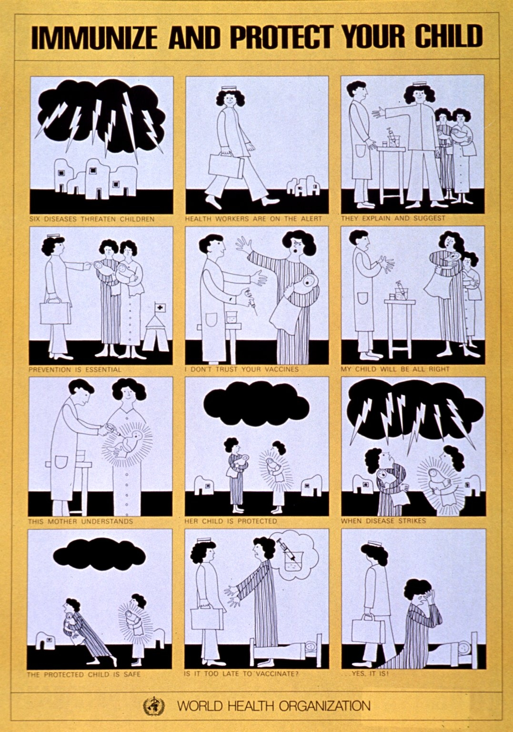
Missed Opportunities
Providers need to check HPV status for adolescents at all encounters
At an average Oregon clinic, half of adolescents have at least one missed opportunity to receive HPV immunization

Slide 25
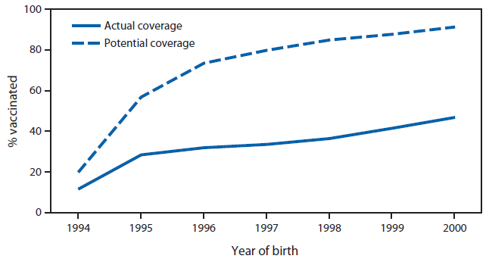
FIGURE. Actual and potentially achievable vaccination coverage with ≥1 dose of human papillomavirus (HPV) vaccine if missed vaccination opportunities had been eliminated among girls by age 13 years,* by birth cohort (1994–2000) — National Immunization Survey-Teen, United States, 2007–2013 combined
Stokley S, Jeyarajah J, Yankey D, Cano M, Gee J, Roark J, Curtis RC, Markowitz L. Human papillomavirus vaccination coverage among adolescents, 2007-2013,
and postlicensure vaccine safety monitoring, 2006-2014--United States. MMWR. Morbidity and mortality weekly report. 2014 Jul;63(29):620-4.

Slide 26
TABLE 2. Top five reasons for not vaccinating adolescents with human papillomavirus (HPV) vaccine* — National Immunization Survey-Teen, United States, 2013
Parents of girls |  |  | Parents of boys
Reason | % | (95% CI) | Reason | % | (95% CI)
Lack of knowledge | 15.5 | (13.0–18.5) | Not recommended | 22.8 | (20.6–25.0)
Not needed or necessary | 14.7 | (12.5–17.3) | Not needed or necessary | 17.9 | (15.9–20.1)
Safety concern/Side effects | 14.2 | (11.8–16.8) | Lack of knowledge | 15.5 | (13.7–17.6)
Not recommended | 13.0 | (10.8–15.5) | Not sexually active | 7.7 | (6.4–9.2)
Not sexually active | 11.3 | (9.1–13.9) | Safety concern/Side effects | 6.9 | (5.6–8.5)
Abbreviation: CI = confidence interval. * Analysis limited to parents reporting that they were not likely to seek HPV vaccination for their teen in the next 12 months or were unsure of their HPV vaccination plans.
Stokley S, Jeyarajah J, Yankey D, Cano M, Gee J, Roark J, Curtis RC, Markowitz L. Human papillomavirus vaccination coverage among adolescents, 2007-2013,
and postlicensure vaccine safety monitoring, 2006-2014--United States. MMWR. Morbidity and mortality weekly report. 2014 Jul;63(29):620-4.

Slide 27
Another (Oregon) Factor on HPV
Parent’s own behavior is a factor-
Parents who don’t seek shots for themselves are less likely to seek HPV immunization for their children
Encouraging parent immunization may be another way to improve adolescent immunization.

Slide 29
Create Opportunities
Expand access to HPV at other sites (pharmacies, school-based health centers)
Encourage more routine adolescent visits
Providers need to actively check for & recommend HPV at all encounters
Need to identify and address local barriers to above; financial, training, and organizational.

Slide 30
Questions?
Steve Robison
Steve.g.robison@state.or.us

