Slide 1
Addressing Vaccine Hesitancy
Intervening to increase vaccine uptake
Jennifer Sienko, MPH
Director, National HPV Vaccination Roundtable, Communications and Public Engagement

Slide 2
Poll:
How confident are you in your ability to effectively respond to vaccine hesitancy?
Is zero a confidence? I am very nervous about this issue.
I am somewhat confident, but I could use some practice.
I am super confident! I’m just here for some pointers.

Slide 3
Notes:
Where does vaccine hesitancy come from?

Slide 4
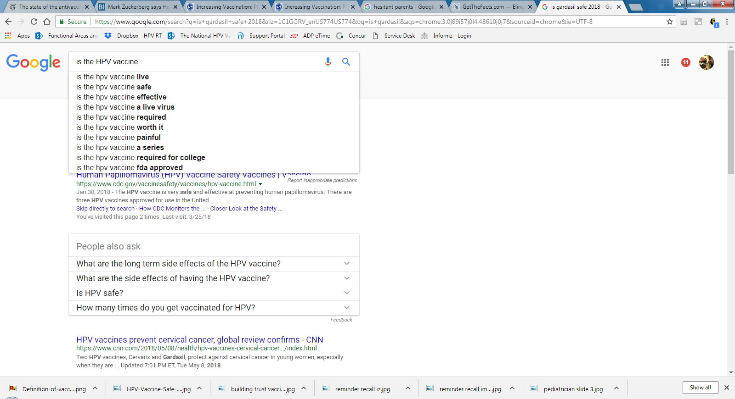
Notes:
We know that there have been declining confidence in all vaccines. I work on the HPV vaccine so I’ve used that as my example here. Parents seem to have a lot of questions about the HPV vaccine or the measles vaccine that they don’t have about Tdap or meningococcal vaccines. Parents might read a scary story on Facebook or the social norm in their community is not strongly supportive of vaccination and they bring those concerns into the clinic for you and your team to address.

Slide 6
Dubé, E Institut National de Santé Publique du Québec, Canada
Notes:
Vaccine hesitancy, defined as the reluctance or refusal to be vaccinated or to vaccinate your children, has been identified by the World Health Organization as one of the top 10 global health threats of 2019.
People who are militantly anti-vaccine are rare. These are people who are not going to change their minds. They’ve heard the facts and they just don’t care. Those who are skeptical of vaccines are far more common and they are people who may be swayed to accept vaccines. They are fearful, but not closed off.

Slide 7
Asking questions or expressing concern does not equal vaccine refusal.
By Maki Naro

Slide 8
Thank You!
YOU have the power to increase vaccine confidence!
Notes:
Ideally, your parents will accept vaccines easily. The number one thing you can do to make vaccination the default decision is make a strong vaccine recommendation. Pediatricians have some of the greatest influence over whether or not a parent chooses to vaccinate.

Slide 9
Action 1
Make a presumptive recommendation for cancer prevention
Notes:
MAKE A PRESUMPTIVE RECOMMENDATION:
Your recommendation is powerful. Clinician recommendation is the number one reason parents choose to vaccinate their children.
• Studies show that presumptive statements—which are brief statements that assume parents are ready to vaccinate-- are more effective in improving HPV vaccination coverage than conversing with parents in an open-ended discussion.
CDC encourages use of a bundled approach by recommending the HPV vaccine in the same way and on the same day that you recommend other adolescent vaccines.
What does this sound like?
EXAMPLE: “Now that your son/daughter is 11, he/she is due for vaccinations to help protect against meningitis, HPV cancers,
pertussis, and flu. We’ll give those shot sduring today’s visit.”
• Research shows that parents place just as much value on the HPV vaccine as on other adolescent vaccines. They give the HPV vaccine a value of 9+ out of 10—the same value they give to vaccines that protect against meningitis, hepatitis, pertussis, and influenza.

Slide 10
Brewer et al., 2016. Announcements Versus Conversations to Improve HPV Vaccination Coverage: A Randomized Trial. Accessed: http://pediatrics.aappublications.org/content/pediatrics/early/2016/12/01/peds.2016-1764.full..pdf on Dec. 9, 2018.
Notes:
Research has shown a specific tactic, called the announcement approach or presumptive approach, works best to increase HPV vaccine acceptance. You announce that the child is due for 3 recommended vaccines. If the parent is hesitant, ask them what their specific concern is. This is more effective than trying to preemptively address any and all possible concerns. Ease their main concern and again strongly recommend the vaccines.
This approach can be used to recommend other vaccines as well.

Slide 11
#HowIRecommend
Notes:
We know that parents have concerns about the HPV vaccine that they don’t have about other vaccines. The CDC has developed a video series called “How I Recommend” highlighting clinicians as they explain how they are achieving high HPV vaccination rates and effectively addressing HPV vaccination questions in their practice. They can be found on the CDC website by searching for #howirecommend

Slide 12
Action 2
Answer parents’ questions
Notes:
Answer parents’ questions
Parents look to you when it comes to their child’s health. Answering parents’ questions effectively is an important step in building trust.
After you make a presumptive recommendation, be prepared to answer parents’ questions. Inform your patients and their parents about the importance of getting the HPV vaccine and let them know that the HPV vaccine is cancer prevention.
Emphasize that the vaccine is safe, effective, and prevents cancer.
Provide parents with fact sheets about the vaccine as needed.

Slide 13
Common Questions
Does my child really need this vaccine?
Is the vaccine safe?
I heard that this will make my child… sick/sexually active/infertile/get cancer
If it’s so necessary, why isn’t required for school?

Slide 14
What’s the best response that you have used or heard to address vaccine hesitant parents? (use the chat box to share)

Slide 15
What you say matters.
How you say it matters more.

Slide 16
How NOT to talk to vaccine hesitant parents
lots of statistics
dismissal
judgment
Notes:
Statistics are not effective tools to sway us from emotional thinking. You can see this in your own life. Imagine you are at the beach and just before swimming out into the ocean with your children, someone walks up to you and says, “oh I wouldn’t go in there. There are sharks. Look at this graphic picture of a shark attack victim. Do you want that to happen to your kids? If you go in there, it could definitely happen.”
If someone came along and said to you in that moment, “Of course there are sharks in the ocean but the probability of you being attacked by one is 1 in 11.5 million.” would you be swayed? I wouldn’t be. I have a visceral fear of sharks and numbers are not going to change that.
When given time and opportunity, we can be rational but people are not computers. We don’t evaluate risk by examining the relative probabilities of different events. Using a lot of statistics or numbers is not going to make me less afraid of sharks and it probably won’t make them less afraid to vaccinate.
Another way not to address parents is to dismiss their concerns. The number one thing to remember is that vaccine-hesitant parents are not dumb or stupid. They have been made afraid by incredibly sophisticated propaganda that is intentionally designed to play on their fears. Telling them “vaccines are safe and your doctor knows best” just shuts down the conversation around an emotional topic for these parents. If you don’t answer their questions, they will go to the internet and their peers looking for answers and most likely they will encounter more myths and more scary stories.
Beware of your tone when talking to vaccine hesitant parents. Perhaps this is your third conversation about vaccines in an hour. It is totally normal for you to feel frustrated or worn out. But this is their 1st conversation with you about it. Judgement shuts down dialogue.
The bottom line is, hesitancy comes from a place of fear and must be approached accordingly.

Slide 17
Empathy
Advice from a pediatrician
Real stories about risks of not vaccinating
Notes:
What CAN vaccine hesitant parents hear?
Empathy, advice, and real stories about the risks of not vaccinating. There is evidence that pediatricians are more successful when they relate to parents as parents themselves, to show – with empathy – that they understand what parents are dealing with.
A 2016 report from the AAP advised pediatricians to “have compassionate dialogues with parents to clear up misconceptions around vaccines, provide accurate information about the safety and importance of vaccines and strive over time to help parents make the decision to vaccinate their child.” https://www.aap.org/en-us/about-the-aap/aap-press-room/Pages/American-Academy-of-Pediatrics-Publishes-New-Policies-to-Boost-Child-Immunization-Rates.aspx

Slide 18
Start with compassion not judgement.
Use simple facts that address specific concern or question.
Avoid restating the myth or rumor.
Share personal experience
Reinforce vaccination as the norm in your clinic, practice or office.
Stephan Lewandowsky, Ullrich K. H. Ecker, Colleen M. Seifert, Norbert Schwarz, and John Cook (17 September 2012)
Notes:
Here are some easy steps to have compassionate dialogue.
Start with compassion
Keep is simple and specific
Whenever possible – avoid restating the myth or the rumor
If it feels natural – share your personal experience
Finally, reinforce vaccination as the norm in your clinic, practice or office.
There is a great handbook by Lewandowsy and colleagues that walks through the science behind this approach for those interested in more details.

Slide 19
“Is the HPV vaccine safe?”
Yes, the HPV vaccine is very safe. What is your specific concern?
This vaccine is so new. How do we know it’s safe?
I'm glad you brought that up. the HPV vaccine is older than <son/daughter> and has been studied in clinical trials for years to make sure it is safe.
Are there any serious side effects?
Vaccines are safe but as you know injections can hurt and there may be lingering pain and swelling where we give the shot.
Notes:
The specific concern being expressed is one of safety. Use simple, direct language to respond and end by reinforcing vaccination as the norm in your clinic. Use language like, “The parents in our clinic vaccinate to protect their kids from infections that can cause terrible diseases.” Or share your personal story as a parent who vaccinated. “I vaccinated my kid(s) against HPV to protect them from HPV diseases and cancer.”
If parents ask about side effects, don’t be afraid to tell them that yeah – shots can hurt! Being honest about the experience helps build trust.

Slide 20
“Why does my child need this vaccine?”
We recommend the HPV vaccine for all 9-12 year old boys and girls to protect against cancers caused by HPV infections.
Fair warning, some people might try to trick you into thinking the vaccine doesn’t provide long-lasting protection, but we know that the vaccine works in the body for at least 12 years without becoming less effective.
In fact, the vaccine works so well, that when given at (patient’s age), they only need 2 doses instead of 3.
We strongly recommend the HPV vaccine in this clinic because HPV vaccination could prevent up to six cancers.
Notes:
In this example, the specific concern is efficacy. Instead of saying, the vaccine is extremely efficacious in preventing infection with several high and low risk HPV types, use simple natural language.
The third bullet here is important - If you want to dispel a myth or inaccuracy – be sure to prepare the parent by telling them that what you are about to say is not true or a myth and then replace the inaccurate statement with a more compelling statement. If the myth is that the vaccine doesn’t work or doesn’t work for long, you dispel that and replace it by sharing the fact that the vaccine works so well that now only 2 shots are needed instead of 3.

Slide 21
“I heard…<insert scary story>”
I can understand why you would be concerned after hearing that.
If I didn’t know all the safety data and research showing the safety and benefits of HPV vaccination, I would be concerned too.
The truth is the HPV vaccine is… safe/works/is important for boys and girls.
I’m glad you asked me this question. If you are looking for accurate information about the HPV vaccines, we use the CDC, the American Academy of Pediatrics, and the American Cancer Society websites.
The information I am sharing with you is supported by research done here and around the world.
Our entire team is dedicated to doing everything we can to protect your son/daughter and that includes giving routine vaccinations.
Notes:
A lot of parental hesitancy can be distilled down to a nameless fear that the vaccine will somehow lead to harm. This fear may wear many different concerns as a disguise. Perhaps it’s first about safety and then about necessity and then they tell you about a story they heard or aluminum or want to know about the possibility of overloading an immune system. Parents want to do what is best for their children and it is ok if they have questions or concerns. Everyone one in your office should be prepared to respond to these questions they way they would respond to anyone experiencing fear or misapprehension. Start from a place of compassion. These questions and concerns are not an attack on your expertise or your knowledge. The opposite – they are asking you because they trust you. Honor that trust with empathy, active listening, and patience.

Slide 22
You’ve made vaccination the norm in your clinic, set up systems to facilitate action and reduce barriers, given a presumptive recommendation and answered questions and the parent still refuses… that’s OK!
Try again next time!
Notes:
Most parents choose vaccination. If they decline in one visit, it does not mean they will decline in the next. Keep trying at every office visit – both routine and acute.

Slide 23
American Cancer Society
https://www.cancer.org/healthy/hpv-vaccine.html
CDC #HowIRecommend Video Series
https://www.cdc.gov/hpv/hcp/how-I-recommend.html
National HPV Vaccination Roundtable Resource Library
http://hpvroundtable.org/resource-library
Notes:
Unlike tests in school - When answering questions parents may have about vaccines, you are allowed to copy your neighbor. You do not have to come up with all the answers on your own. Several organizations, including the CDC, ACS, AAP and others have created resources to help you make strong vaccination recommendations and respond to HPV vaccine concerns.

Slide 26
Compassion
Simple Facts
Avoid Myths
Personal Stories
Pro-immunization Culture
Notes:
When responding to vaccine hesitancy, remember:
Start with compassion not judgement.
Use simple facts that address specific concern or question.
Avoid restating the myth or rumor.
Share personal experience
Reinforce vaccination as the norm in your clinic, practice or office.

Slide 27
Poll:
Do you feel more confident in your ability to respond to HPV vaccine hesitancy than before this webinar?
Yes! I learned what I need to know to address vaccine hesitancy!
Somewhat. I learned some new things, but I still need practice.
Not really. I was hoping for …(put in the chat box a resource that would help you feel more confident)

Slide 28
Thank You!
Jennifer Sienko, MPH
Jennifer.Sienko@cancer.org
Director, National HPV Vaccination Roundtable, Communications and Public Engagement
www.hpvroundtable.org

